Slide 1
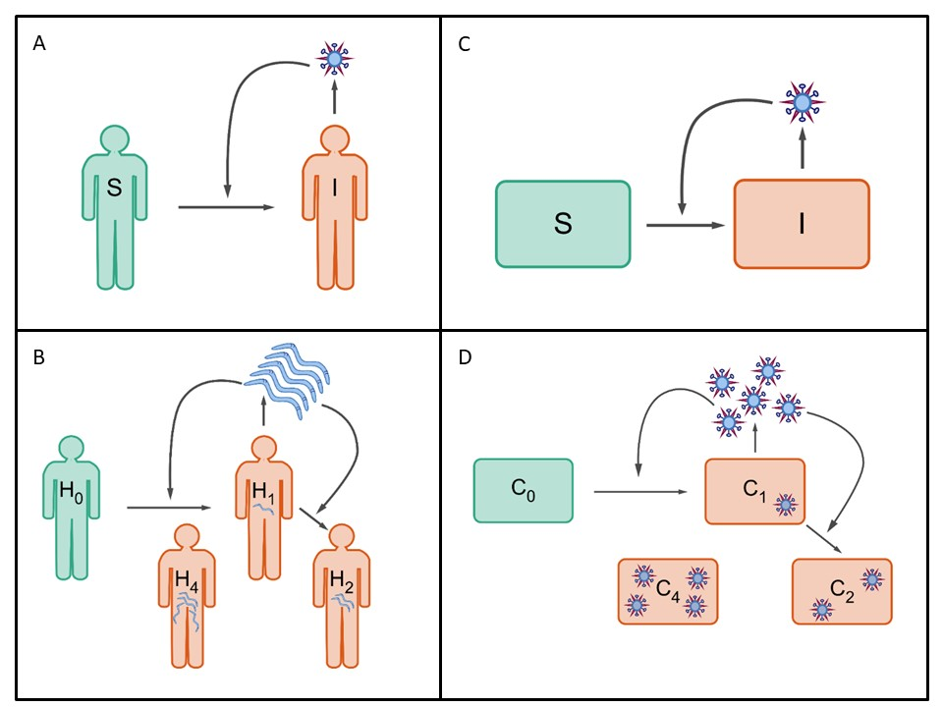







Main finding goes here, translated into plain English. Emphasize the important words.
Non-Cognitive Predictors of Student Success: A Predictive Validity Comparison Between Domestic and International Students
Non-Cognitive Predictors of Student Success: A Predictive Validity Comparison Between Domestic and International Students
Complex viral dynamics emerge in vivo from collections of heterogeneously-responding infected cells
‘Macroparasite framework
Jeremy D. Harris¹, Brigitte Martin², Christopher B. Brooke^{2,3}, Katia Koelle¹
Department of Biology, Emory University
Department of Microbiology, University of Illinois at Urbana-Champaign
Carl R. Woese Institute for Genomic Biology, University of Illinois at Urbana-Champaign
Epidemiological macroparasite model
Host death rate depends on host’s nematode burden
Nematode production rate depends on host’s nematode burden
Within-host “macroparasite” model
Cell death rate can depend on cellular input
Viral production rate can depend on cellular input
^{koellelab}
Implicit spatial structure
Background
At the within-host level, SIR-type models do not easily allow for consideration of the impact of cellular coinfection on infected cell phenotypes and viral dynamics
Evidence indicates that cellular multiplicity of infection strongly affects infected cell phenotypes in the case of influenza A virus
*Our recently developed within-host ‘macroparasite’-type models can be modified in a scalable manner to accommodate different functional forms for infected cell phenotypes
Approach
We fit a spatially implicit extension of this within-host model to equine influenza data, and show that it can recapitulate in vivo measurements, including viral titer and interferon levels.
RESULTS
Graph or table with essential results only.
All the other correlations in the ammo bar.
DISCUSSION
“If this result actually generalized and I didn’t have to humbly disclaim the possibility of a thousand confounds and limitations, it would imply that….”
Homogeneous mixing
low frequency of coinfection
Spatially structured infection
high frequency of coinfection
Target cells
unavailable
Target cells
available
Infected cells
Virus
Range available to infection
Target cells
unavailable
Target cells
available
Infected cells
Virus
Range available to infection
*Take a picture to download the full paper
Notes:
Notes:
In Powerpoint, click View > Guides
Keep text within gutter guides.
Author list: Don’t split names onto two lines (e.g., “Jimmy [break] Smith”). If that happens, use a new line, unless you need the space. Bold the first names of anybody who’s presenting in person.
Intro/methods/result: Do not drop below font size 28, but if you have extra space, jack up the font size until the space is full.
Do not use color in the sidebars except in graphs/figures. It’ll pull attention from the center and slow interpretation for passersby.

